Slide 1
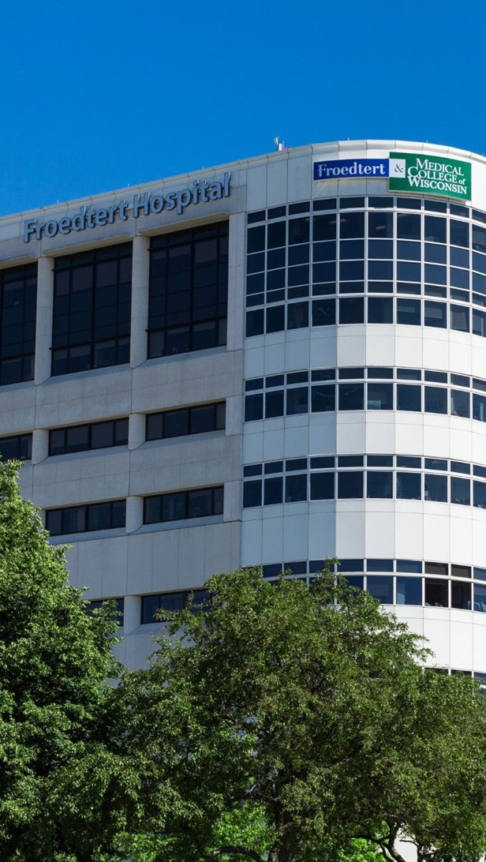


OPPORTUNITY REVIEW
DIRECT-TO-EMPLOYER GTM STRATEGY
Exploring a Froedtert ThedaCare Health DTE Health Plan

Slide 2


Founded in 1979, headquartered in Indianapolis
Largest Independently-Owned Full-Service Third-Party Administrator
Specialize in Administration of Self-Funded Plans and Population Health Management​
Leader in the Direct-to-Employer Movement
We Know and Understand the Market
Experience Working with All Professional Teams: Agents, Networks, MGAs
The Key Family of Companies is a Vertically Integrated group of benefit related organizations
3,000+ Corporate Clients
3 Million Members under Management
700 Employees

Slide 3


MARKET LEADER
IN
PRIVATE LABELED
DTE PLANS
Louisville, KY
Cincinnati, OH
Bentonville, AR
Knoxville, TN
Meridian, MS
Fort Myers, FL

Slide 4


DIRECT-TO-EMPLOYER (DTE)
YOU Pick the Name of the Health Plan
YOU Determine the Fees Charged
YOU Practice the Medicine
YOU Receive the Profits
WE Make it Successful
Your Health Plan Focused on a Direct Relationship with Self-Funded Employers in Your Market

Slide 5
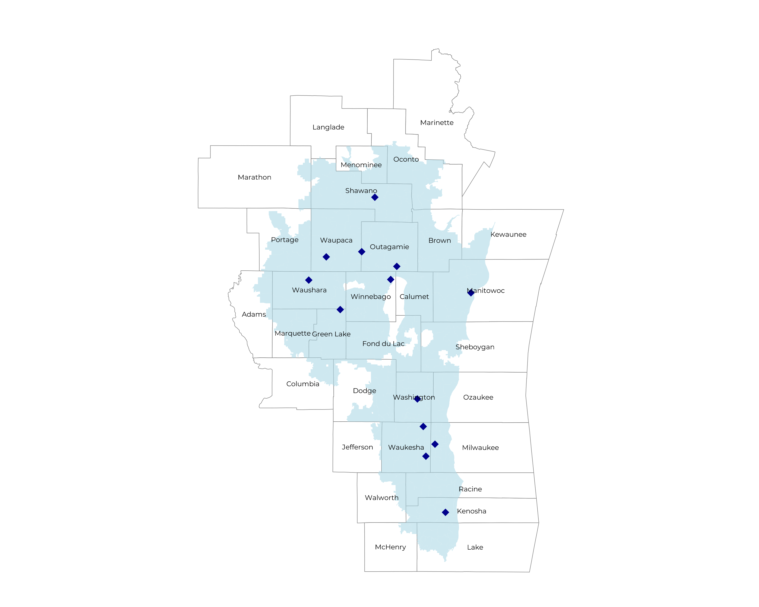
SIGNIFICANT OPPORTUNITY FOR PLAN GROWTH Researched for the below highlighted service area
Target Market 4,400+ Employers 900,000+ Employees 1,700,000+ Members
 | Employer Size Group (# of Employees)
Commercial Employers With Headquarters | 50-100 | 101-200 | 201-400 | 401-1,000 | 1,001-3,000 | 3,000+
In Catchment Area | 2,307 | 1,026 | 619 | 367 | 127 | 78
Total Employees at Employers | 50-100 | 101-200 | 201-400 | 401-1,000 | 1,001-3,000 | 3,000+
Headquartered in Catchment Area | 173,000 | 153,900 | 185,700 | 256,900 | 254,000 | 468,000
Total Members with Employers | 50-100 | 101-200 | 201-400 | 401-1,000 | 1,001-3,000 | 3,000+
Headquartered in Catchment Area | 311,400 | 277,000 | 334,300 | 462,400 | 457,200 | 842,400

Slide 6
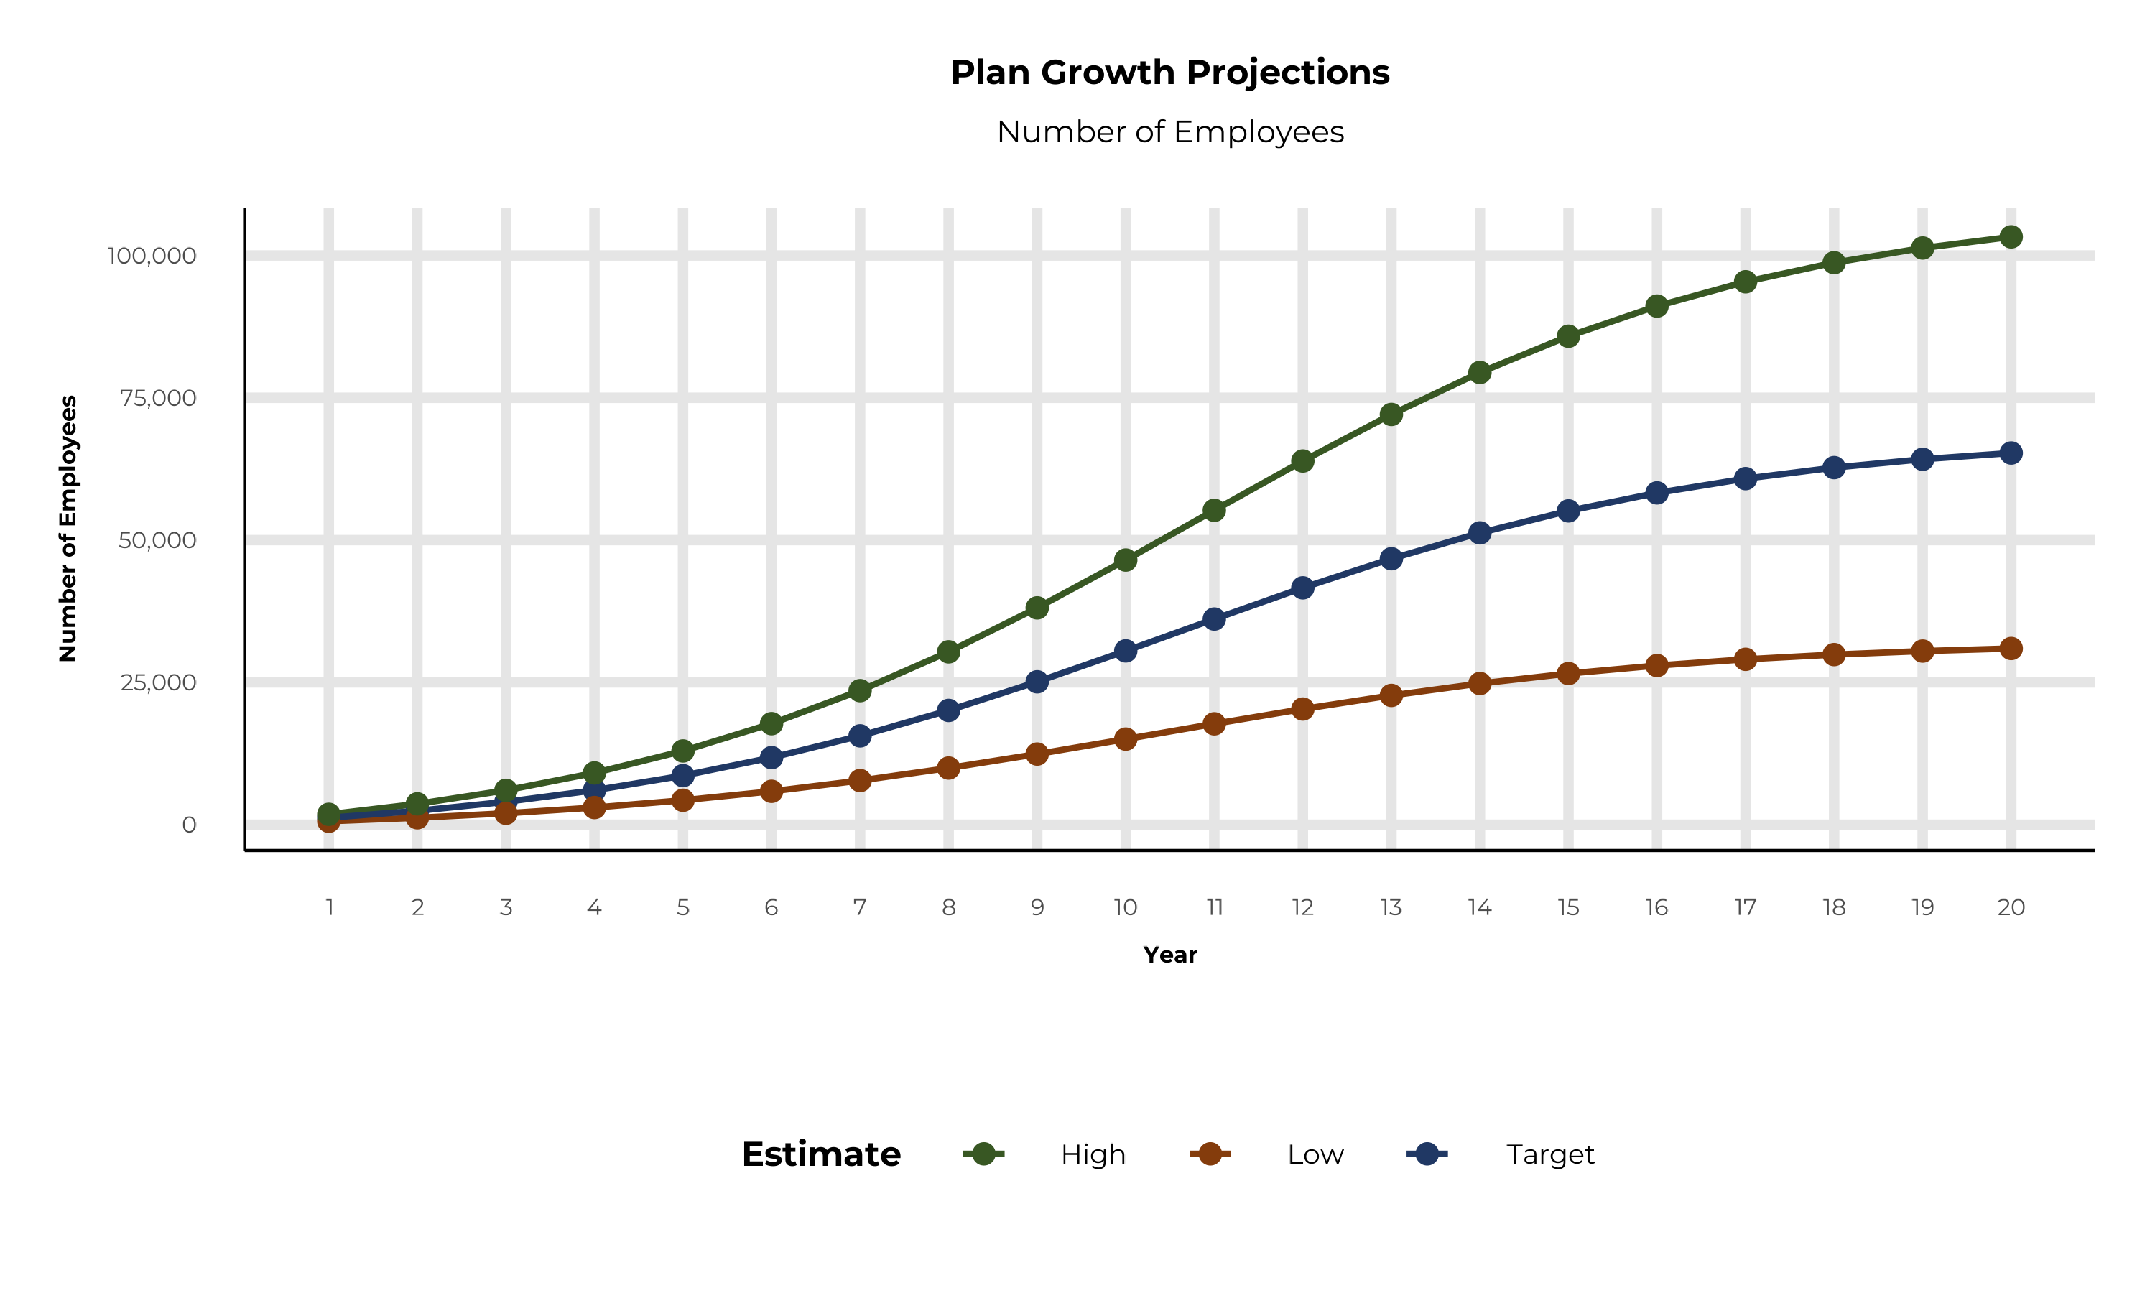
PLAN POTENTIAL GROWTH PATHS
Self Funded
895K
Insured
1,546K
Working Age
2,056K
Population
3,500K
Estimates includes the Froedtert ThedaCare Health service area in Lake, McHenry, Brown, Calumet, Columbia, Dodge, Fond du Lac, Green Lake, Jefferson, Kenosha, Kewaunee, Manitowoc, Marquette, Menominee, Milwaukee, Oconto, Outagamie, Ozaukee, Portage, Racine, Shawano, Sheboygan, Walworth, Washington, Waukesha, Waupaca, Waushara, and Winnebago Counties

Slide 7
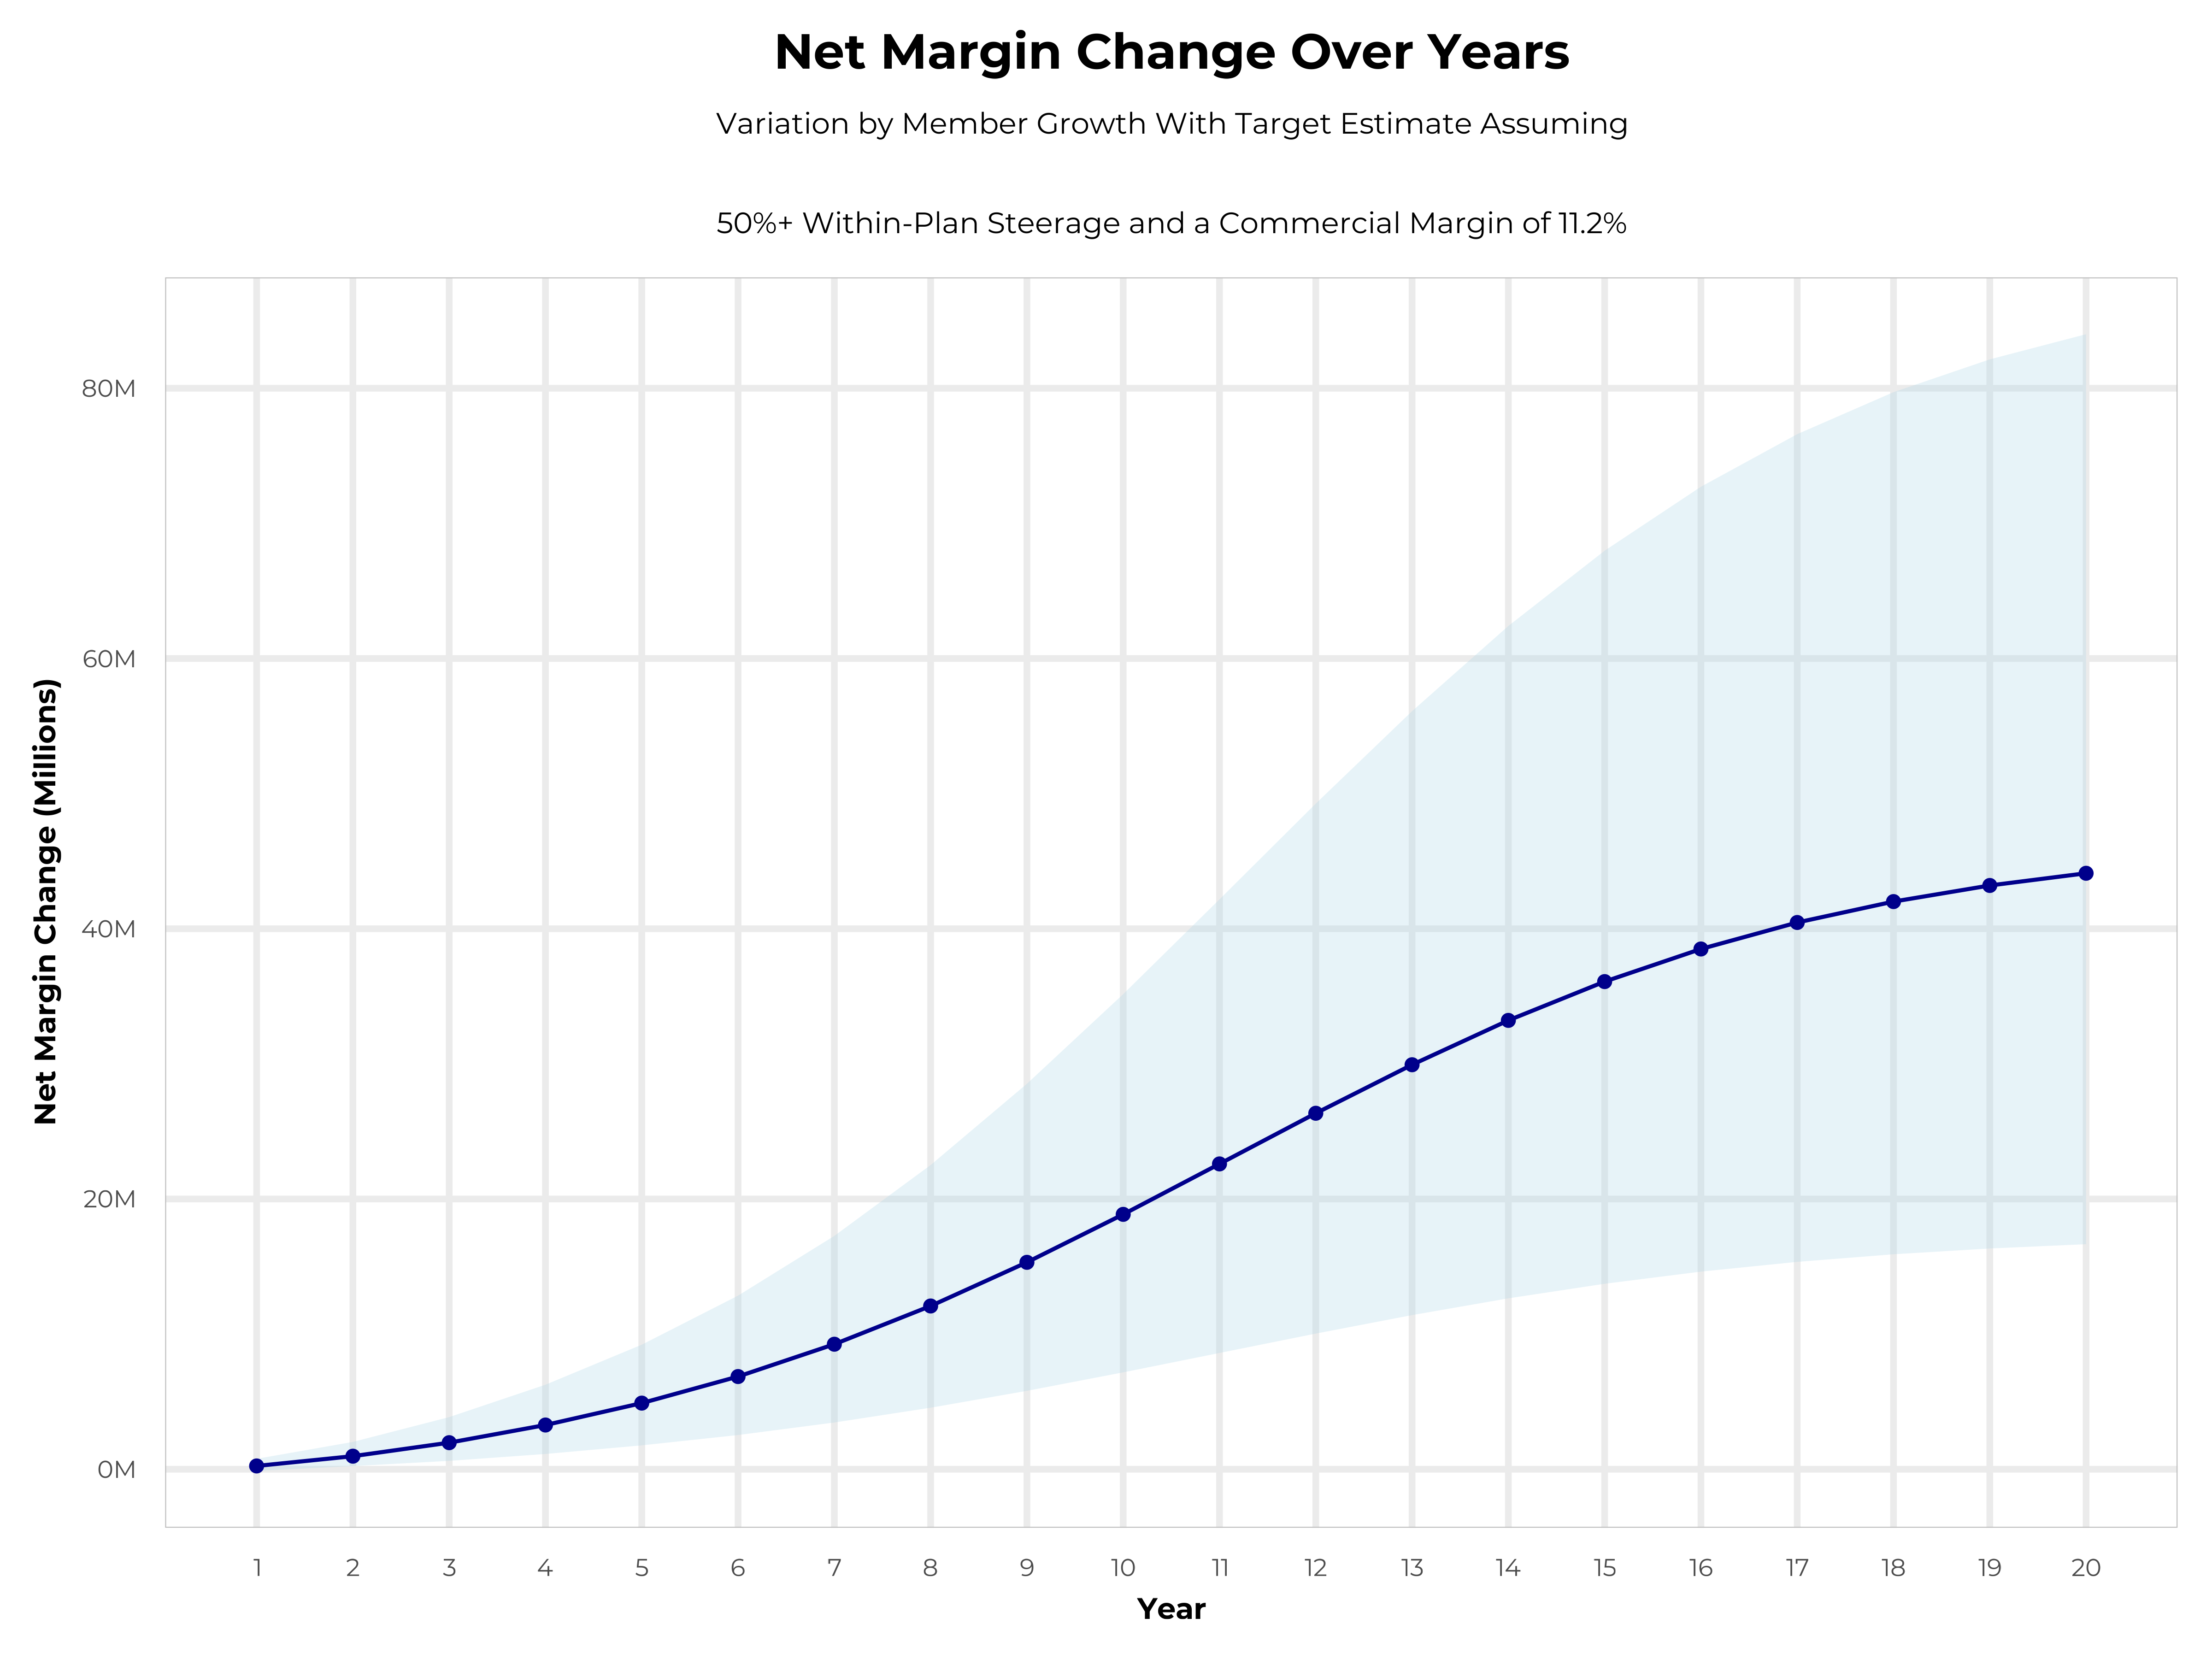
GROWING POWERFUL, LASTING PROFITABILITY
Early Stage
Gaining Name Recognition, Early Growth
New Revenue:
New Profit:
$27.7M
$3.03M
Growth Stage
Strong Reputation, Strong Growth
New Revenue:
New Profit:
$166.41M
$19.2M
Mature Stage
High Profitability, Market Saturation
New Revenue:
New Profit:
$342.88M
$39.66M

Slide 8
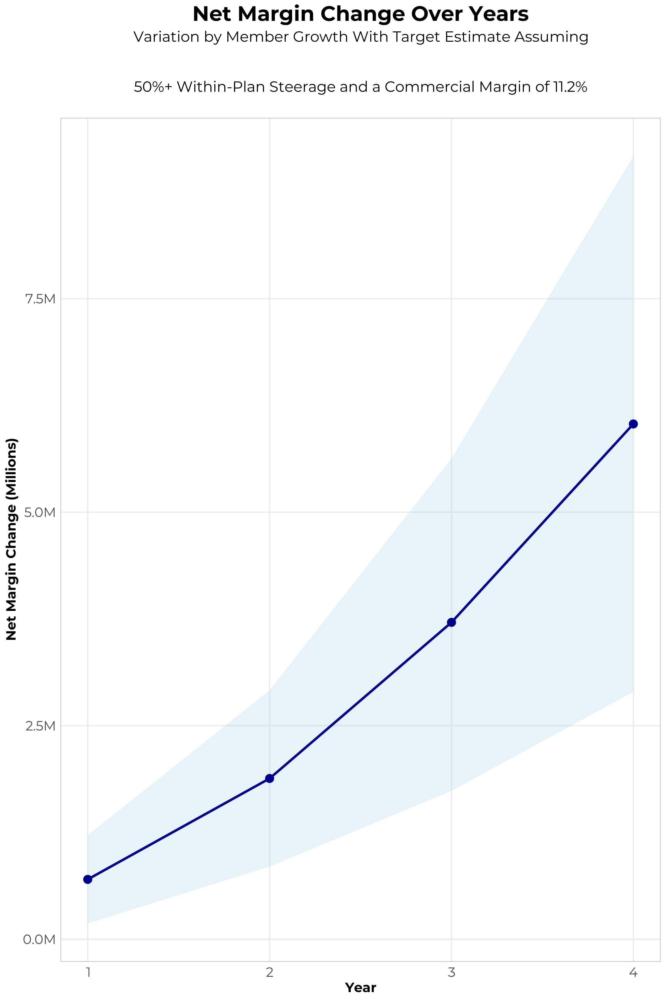
FOUR-YEAR PROJECTIONS
Target Member Growth | Target Member Growth | Target Member Growth | Target Member Growth | Target Member Growth
Metric | Year 1 | Year 2 | Year 3 | Year 4
Number of Members | 2,200 | 4,400 | 7,300 | 10,900
Incremental Margin | 1,004.1K | 2,009.4K | 3,802.0K | 6,081.9K
Network Access Fee | 26.4K | 52.8K | 87.6K | 130.8K
Implementation Fee (One-Time) | -150.0K | 0.0K | 0.0K | 0.0K
Sales and Marketing Costs | -180.0K | -180.0K | -180.0K | -180.0K
Net Margin Change | 700.5K | 1,882.2K | 3,709.6K | 6,032.7K
High Member Growth | High Member Growth | High Member Growth | High Member Growth | High Member Growth
Metric | Year 1 | Year 2 | Year 3 | Year 4
Number of Members | 3,300 | 6,600 | 10,900 | 16,400
Incremental Margin | 1,506.1K | 3,014.1K | 5,677.0K | 9,150.7K
Network Access Fee | 39.6K | 79.2K | 130.8K | 196.8K
Implementation Fee (One-Time) | -150.0K | 0.0K | 0.0K | 0.0K
Sales and Marketing Costs | -180.0K | -180.0K | -180.0K | -180.0K
Net Margin Change | 1,215.7K | 2,913.3K | 5,627.8K | 9,167.5K
Low Member Growth | Low Member Growth | Low Member Growth | Low Member Growth | Low Member Growth
Metric | Year 1 | Year 2 | Year 3 | Year 4
Number of Members | 1,100 | 2,200 | 3,600 | 5,400
Incremental Margin | 502.0K | 1,004.7K | 1,875.0K | 3,013.0K
Network Access Fee | 13.2K | 26.4K | 43.2K | 64.8K
Implementation Fee (One-Time) | -150.0K | 0.0K | 0.0K | 0.0K
Sales and Marketing Costs | -180.0K | -180.0K | -180.0K | -180.0K
Net Margin Change | 185.2K | 851.1K | 1,738.2K | 2,897.8K

Slide 9
PROJECTED PLAN GROWTH
Year | Employees | Members | Percent of Members Choosing Froedtert ThedaCare Health for Inpatient Care | Percent of Members Choosing Froedtert ThedaCare Health for Outpatient Care
1 | 1,200 | 2,200 | 60% | 50%
2 | 2,400 | 4,300 | 60% | 50%
3 | 4,000 | 7,200 | 65% | 55%
4 | 6,100 | 11,000 | 67% | 58%
5 | 8,600 | 15,500 | 68% | 60%
6 | 11,800 | 21,200 | 68% | 60%
7 | 15,600 | 28,100 | 69% | 61%
8 | 20,100 | 36,200 | 69% | 62%
9 | 25,100 | 45,200 | 69% | 62%
10 | 30,500 | 54,900 | 70% | 63%
11 | 36,100 | 65,000 | 70% | 63%
12 | 41,600 | 74,900 | 70% | 64%
13 | 46,700 | 84,100 | 71% | 64%
14 | 51,300 | 92,300 | 71% | 65%
15 | 55,100 | 99,200 | 71% | 66%
16 | 58,300 | 104,900 | 72% | 66%
17 | 60,800 | 109,400 | 72% | 66%
18 | 62,700 | 112,900 | 72% | 67%
19 | 64,200 | 115,600 | 72% | 67%
20 | 65,300 | 117,500 | 72% | 67%
KBA currently estimates that Froedtert ThedaCare Health has 24% inpatient market share, and 17% outpatient market compared to hospitals/clinics in the Froedtert ThedaCare Health service area (see slide 8).
Based on previous DTE experience, KBA expects a significant bump in patient steerage to Froedtert ThedaCare Health.
Additional steerage will occur from additional steerage patient benefits and the patient convenience card.
High estimates start nearly 10% higher than target with low estimates at 10% lower than target

Slide 10
YEAR 4 PROJECTED REVENUE AND PROFIT
Pre-DTE Cohort of 10,900 Employees | Inpatient | Outpatient | Professional | Total
Revenue† | $ 8,209,441 | $ 10,821,112 | $ 5,053,367 | $ 24,083,920
Net Income‡ | $ 919,457.4 | $ 1,211,965 | $ 565,977.1 | $ 2,697,399
† Assuming proportional revenues from market shares of 24% (inpatient) and 17% (outpatient)
‡ Conservatively assuming a commercial margin of 11.2% (80% of the estimated commercial margin)
With DTE | Inpatient | Outpatient | Professional | Total
Revenue⁰ | $ 23,396,414 | $ 36,688,823 | $ 17,133,369 | $ 77,218,606
Net Income* | $ 2,620,398 | $ 4,109,148 | $ 1,918,937 | $ 8,648,484
⁰ Assuming 67% inpatient and 58% market steerage based on KBA narrow network DTE experience (see previous slide)
* Conservatively assuming a commercial margin of 11.2%, with a 10 percentage-point reduction to reflect competitive-edge rates and a 10 percentage-point increase due to lower billing costs and higher patient responsibility collections because of the member convenience card.
Total Increase in Net Income | $ 5,951,085
Network Access Fee (Revenue) of $1 PMPM | $ 130,800
Total Profit Growth | $ 5,955,885
Minus Implementation Fee (One-Time) | -$ 0
Minus Sales and Marketing (Annual – Ongoing) | -$ 180,000
Total | $ 5,901,885

Slide 11





A PARTNER YOU CAN TRUST
OUR OBJECTIVES ARE ALIGNED
WE KNOW THE
MARKET
COMPLETELY TRANSPARENT
WE HAVE THE SOPHISTICATION AND INFRASTRUCTURE TO EFFECTIVELY COMPETE
Derek Moore, Senior Vice President – KBA
845-283-9973 * derek.moore@keybenefit.com

